Slide 1



HealthTrack: Revolutionizing Healthcare Through Technology
HealthTrack is a groundbreaking telemedicine platform that aims to democratize healthcare access, improve patient care, and optimize administrative efficiency. We are building a future where healthcare is convenient, accessible, and connected.
by Cavin Otieno Join Us on Our Mission to Revolutionize Healthcare!
Contact: otienocavin@gmail.com | +254715169531

Slide 2




Addressing the Gaps in Healthcare
Access Barriers
Inefficient Processes
Fragmentation
Limited access to quality healthcare is a major challenge for many patients, especially those in rural areas or underserved communities.
Traditional healthcare systems often struggle with cumbersome appointment scheduling, documentation, and communication processes.
Lack of integration between healthcare providers, patients, and administrative systems creates inefficiencies and delays.

Slide 3

HealthTrack: A Comprehensive Solution
Virtual Consultations
Appointment Management
Connect with doctors and specialists across Kenya, even in remote areas, for instant and personalized care.
Schedule appointments with ease, receive timely reminders, and manage your healthcare needs from anywhere.
Digital Prescriptions
Centralized Records
Get your prescriptions electronically, eliminating the need for trips to the pharmacy and ensuring convenient access to medications.
Keep all your medical information safe and organized, accessible anytime, anywhere.

Slide 4
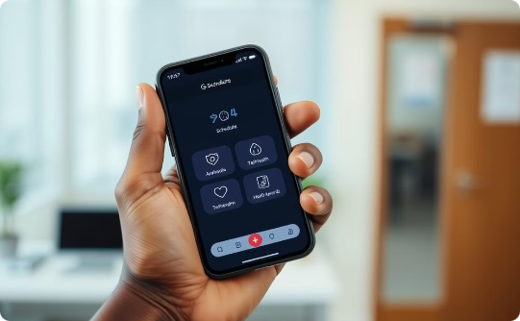


Key Features for Diverse Users
Patients
Doctors
Admins
Easy appointment booking, secure messaging, virtual consultations, medical record access.
Access to patient records, seamless scheduling, digital prescription issuance, secure messaging.
User management, system monitoring, data analytics, report generation, security control.

Slide 5





Robust Technology Stack
Frontend
1
React.js, a popular JavaScript library, powers a dynamic and responsive user interface.
2
Backend
Node.js with Express.js provides robust server-side logic and data processing.
3
Database
MySQL ensures secure and efficient storage of structured patient data.
4
Cloud Services
AWS offers scalable hosting, storage, and other cloud-based services.
Security
5
JWT for secure authentication and SSL for encrypted communication ensure data protection.

Slide 6

Differentiating HealthTrack
Comprehensive Suite
Customizable Workflows
Combines appointment scheduling, virtual consultations, digital prescriptions, and centralized medical records for a complete solution.
Tailored functionalities for patients, doctors, and administrators cater to specific needs.
Granular Tracking
User-Friendly Design
Unique system to monitor user interactions, medical processes, and system health, enabling real-time insights.
Simple and intuitive UI/UX design ensures easy navigation and accessibility for all users.

Slide 7
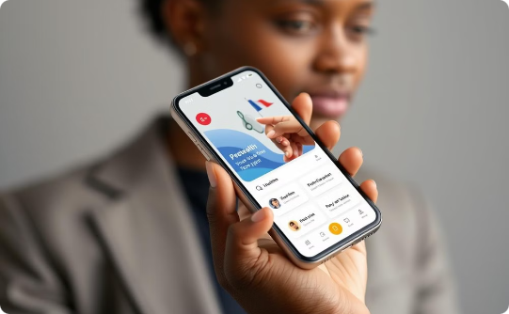


A Sustainable Business Model
Freemium
Partnerships
Pay-per-Use
Basic features and consultations are free, while premium subscriptions unlock advanced functionalities.
Collaborations with hospitals, clinics, and insurance companies expand reach and revenue.
Charges for specific services like detailed reporting, advanced analytics, and customized integrations.

Slide 8

Unlocking a Vast Market Opportunity
91.2B
Market Size (2023)
The global telemedicine market is rapidly expanding.
380B
Projected Size (2030)
Reaching a massive USD 380 billion by 2030.

Slide 9
A Strategic Roadmap for Success
1
2
3
Phase 1: Build & Launch
Phase 2: Expand & Refine
Phase 3: Global Reach
Development of core functionalities: appointments, consultations, prescriptions, digital records, and MVP release for pilot testing.
Integration of advanced features: payment gateway, analytics, reporting, and expansion to hospitals and clinics.
Launch of mobile application, global expansion with multilingual support, and continued innovation.

Slide 10





The HealthTrack Team
Project Lead
Backend Development
Cavin Otieno Ouma - Senior Python Developer
Cavin Otieno Ouma
Frontend Development
UI/UX Designer
Cavin Otieno Ouma
Cavin Otieno Ouma

